Slide 1
The AI landscape for leaders
What is AI, in plain words, and where is it already at work in my industry?
Leading with AI | Session 0 of the 15, the introduction
KLAi Professional Learning | Jotham Martin Wambi
Notes:
Welcome to Leading with AI. This is Session 0, the introduction, so there is no earlier session to recall. Over fifteen sessions we look at where AI pays in your industry and how to lead your people through it, with no maths and no code. Today draws the map: what AI is in plain words, where it already works in East Africa and beyond, and where your own organisation could start.
Our question is this: what is AI, in plain words, and where is it already at work in my industry?

Slide 2



What you will leave with today
By the end of today you will have
A plain picture of AI as a family, the four jobs it does, and what it is good and bad at
A view of where AI already works in six industries, with real cases and their catches
Your chosen industry and the first two entries in your AI Opportunity Portfolio
Notes:
To answer that question, you leave today with three things. A plain picture of AI as a family, the four jobs it does, and what it is good and bad at. A view of where AI already works in six industries, with real cases and their catches. And your own start: your chosen industry and the first two entries in your AI Opportunity Portfolio.

Slide 3
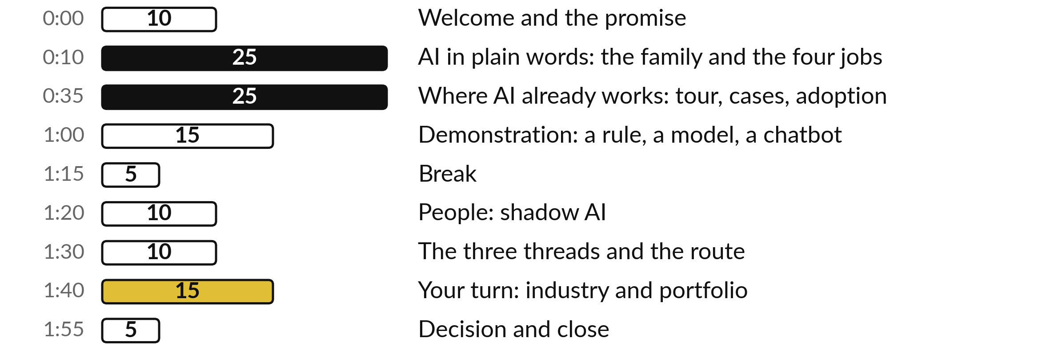
Your two hours: the map, the
evidence, then your first page
Before we close, you choose your industry and start your portfolio.
Notes:
Ten minutes of welcome and the promise of the course. Twenty-five minutes on AI in plain words: the family, how a model learns, and the four jobs. Twenty-five minutes on where AI already works, with an industry tour, three cases and the adoption figures. A fifteen-minute recorded demonstration, then a five-minute break.
After the break, ten minutes on your people, ten on the threads and the route of the course, fifteen minutes of your own work, and five minutes to decide and close.

Slide 4
Words we use today
Word | What it means
AI | Artificial intelligence: software that does tasks we link with human thinking, such as reading, predicting and writing.
Machine learning | Software that learns a pattern from past examples, where a rule would be written by a person.
Model | The pattern that machine learning produces, used to make a guess about a new case.
Generative AI | Machine learning that writes new text, pictures or code; ChatGPT is one product of this kind.
AI Opportunity Portfolio | Your one-page register of possible AI uses in your organisation. It grows every session.
Notes:
Five words for today. We use every one of them before the end of the session.
AI. Artificial intelligence: software that does tasks we link with human thinking, such as reading, predicting and writing.
Machine learning. Software that learns a pattern from past examples, where a rule would be written by a person.
Model. The pattern that machine learning produces, used to make a guess about a new case.
Generative AI. Machine learning that writes new text, pictures or code; ChatGPT is one product of this kind.
AI Opportunity Portfolio. Your one-page register of possible AI uses in your organisation. It grows every session.

Slide 5
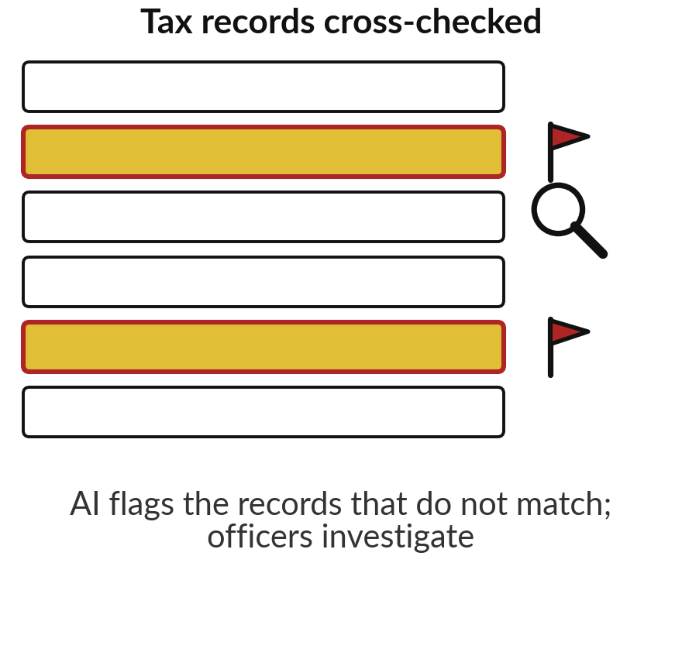
Uganda Revenue Authority says AI helped
it recover UGX 200 billion in one year
200bn
shillings of revenue leakage URA says it uncovered with AI, in the year before April 2025
Source: URA, Commissioner General, 8 Apr 2025: a speech claim, no published method.
Notes:
With those five words in hand, start with a number from home. In April 2025 the Commissioner General of the Uganda Revenue Authority said that in the previous year alone, URA recovered 200 billion shillings in revenue leakage uncovered through AI. The AI cross-checks records, such as imports and VAT claims, and flags the ones that do not match, so officers know where to look.
Two cautions, because you will hear many such claims. It was said in a speech, with no published method or audit. And a URA staff study in 2019 found duplicated phone numbers and several tax numbers for one taxpayer, so clean records matter first; Sessions 11 and 14 come back to URA.
Today is about telling which claims hold, and where AI already works.

Slide 6
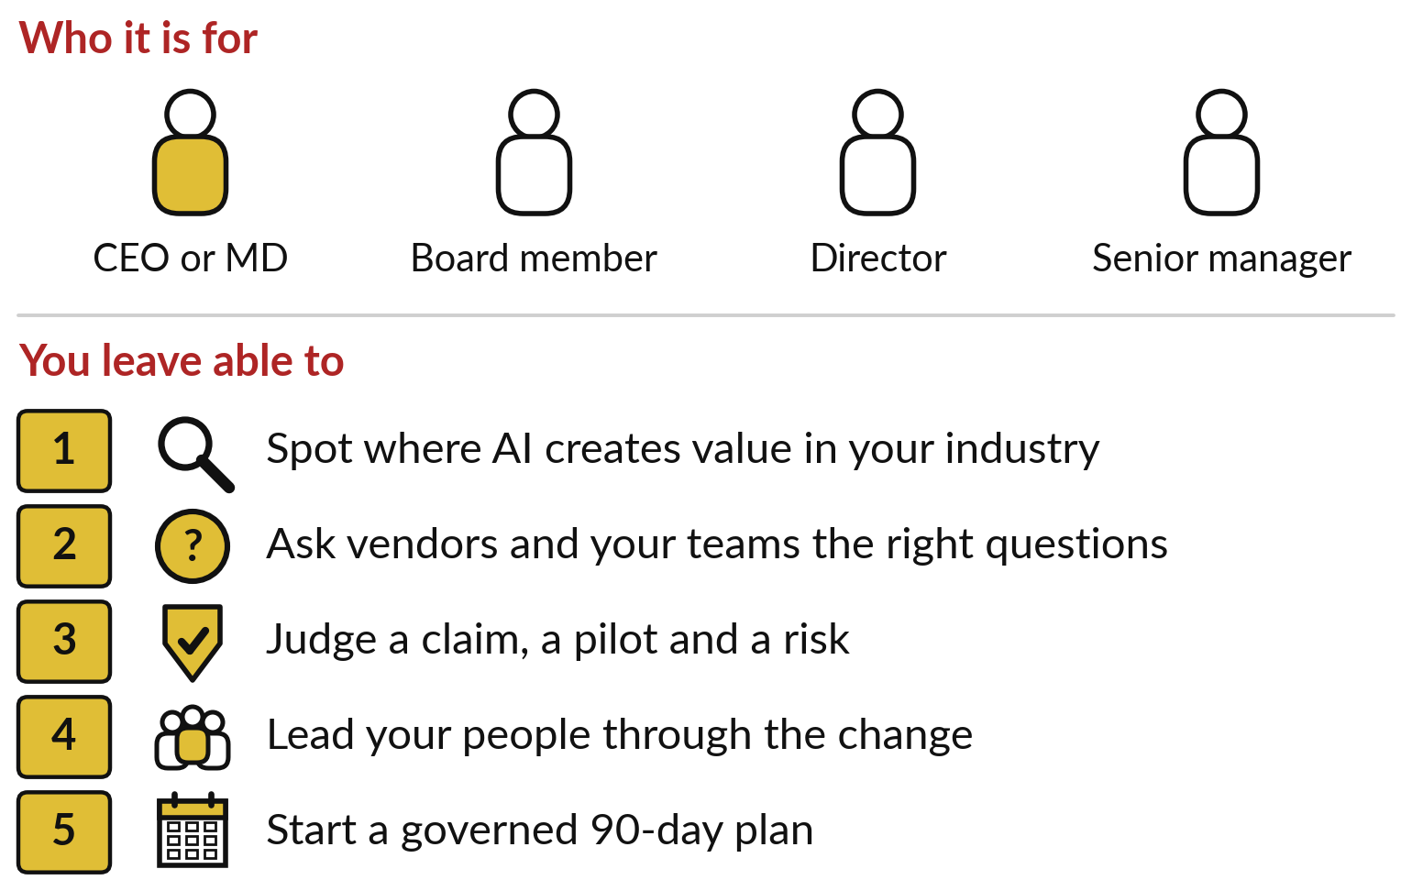
This course is for the people who
decide where AI goes in an organisation
No maths, no coding and no technical background needed.
Fifteen sessions of two hours, each built on the one before.
Uganda and East Africa first, then Africa, then the world.
Notes:
Claims like that one land on leaders’ desks every week, and that is who this course is for: chief executives, managing directors, board members, directors and senior managers, in any sector. You need no maths or technical background, and I teach none. By Session 14 you should be able to do five things.
Spot where AI creates value in your industry. Ask vendors and your own teams the right questions. Judge a claim, a pilot and a risk. Lead your people through the change. And start a costed, governed ninety-day plan. Each session builds on the one before. Which of those five would matter most to your board this year?

Slide 7
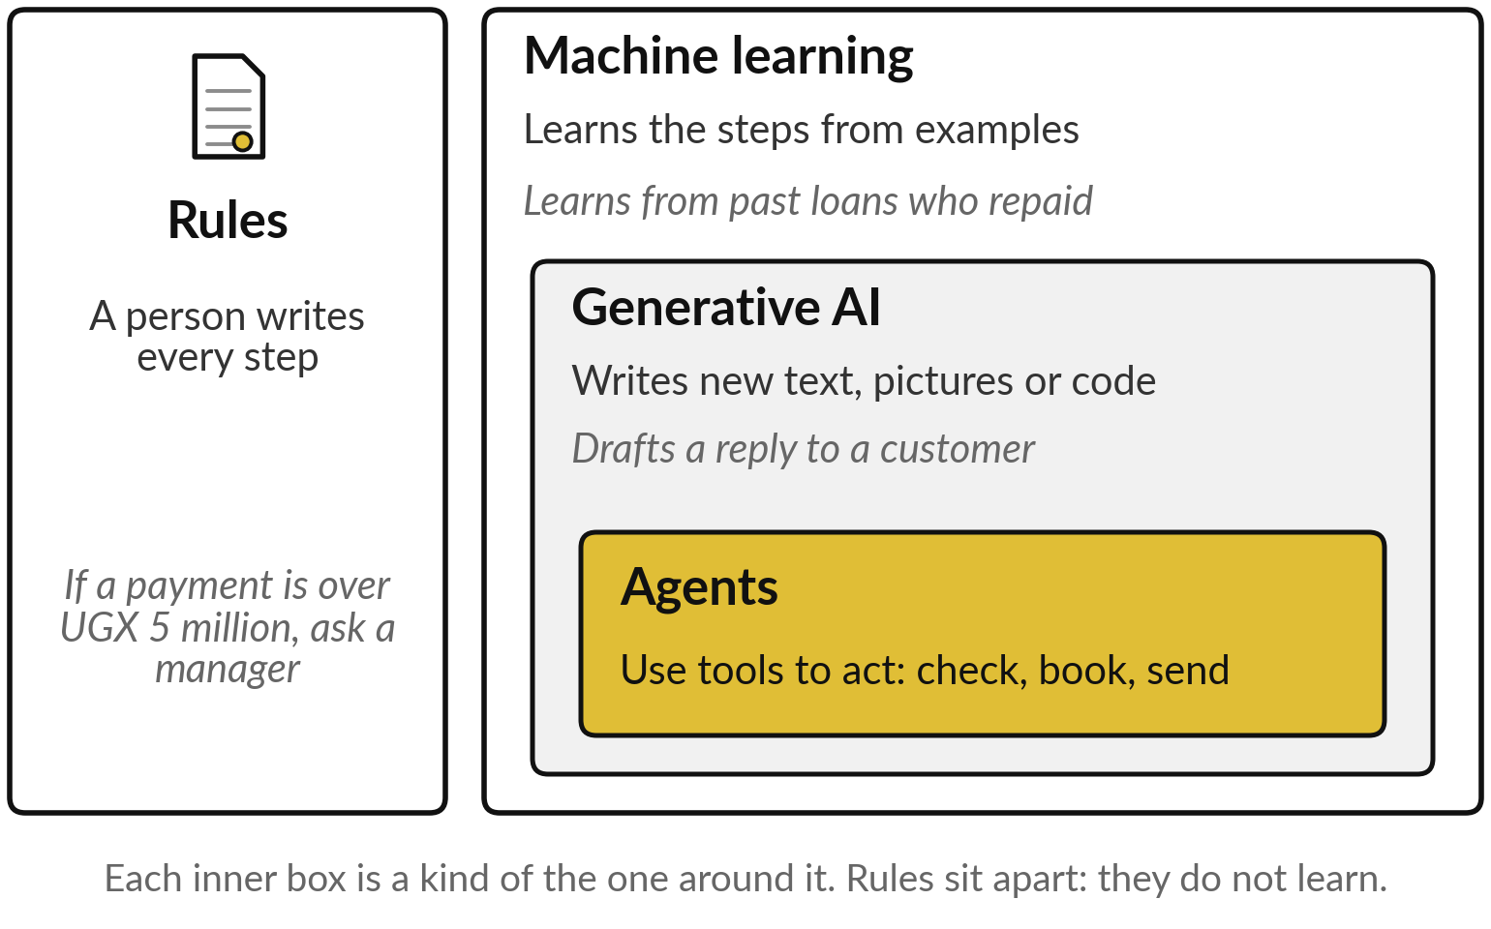
AI is a family: rules, machine
learning, generative AI and agents
When people say AI today, they usually mean generative AI.
Rules are written by people and do not learn.
Each inner box is a kind of the one around it.
Notes:
Whatever your answer, all five start from knowing what people mean when they say AI. So our first block puts AI in plain words, and by its end you can place any product a vendor shows you on one diagram. AI is a family. The oldest member is rules: a person writes every step, such as ask a manager when a payment is over five million shillings.
Machine learning learns the steps from examples, such as which past borrowers repaid. Inside it sits generative AI, which writes new text, pictures or code; ChatGPT is one product of this kind. And inside that sit agents: generative AI given tools so it can act, for example check stock and book a delivery. Session 10 is about agents.

Slide 8
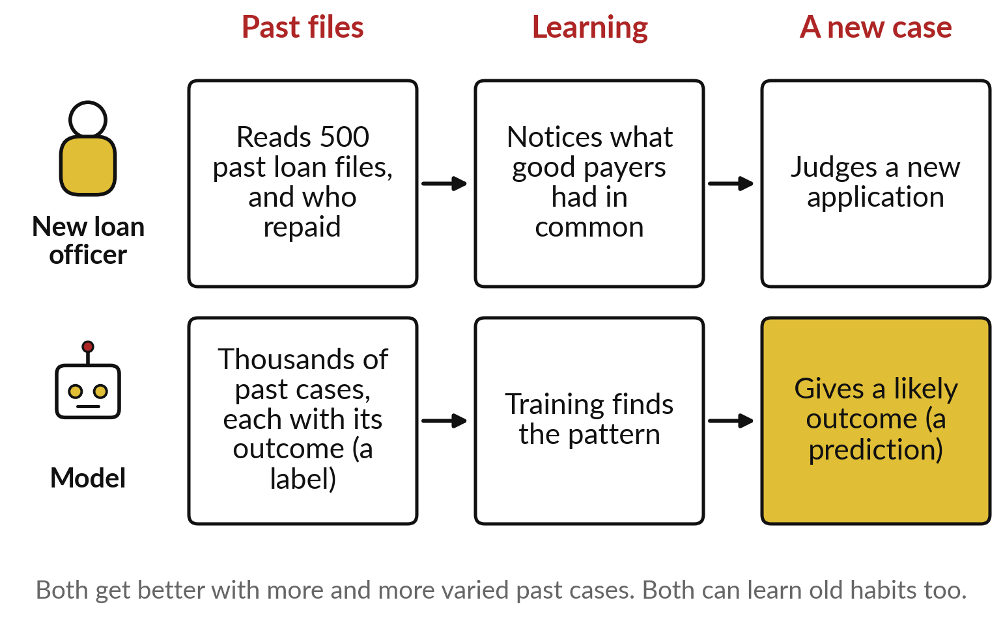
A model learns from examples, the way
a new employee learns from past files
Past cases with known outcomes go in; a pattern comes out, ready for new cases.
The learning step is called training.
Each known outcome is a label. The guess about a new case is a prediction.
Notes:
Machine learning is the member that matters most for the next five sessions, so it is worth seeing how it learns. Picture a new loan officer who reads five hundred past loan files and knows which borrowers repaid. Over time the officer notices what the good payers had in common, and uses that to judge a new application.
A model does the same with thousands of past cases. Each case carries its known outcome, which the industry calls a label. Finding the pattern is called training, and the guess about a new case is a prediction. The analogy also warns you: if the past files carry old habits, such as unfair lending, the model learns those too.
What past files does your organisation hold?

Slide 9
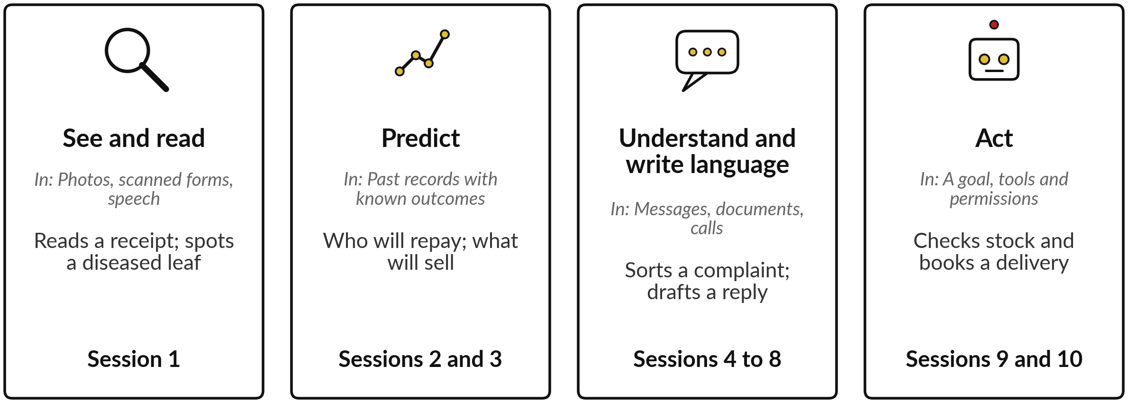
AI does four kinds of job, and Sessions
1 to 10 take them one at a time
Every AI use in your industry is one of these four jobs, or a chain of them.
Notes:
Those past files can feed many different uses, and it helps to sort the uses into four kinds of job. First, see and read: photos, scanned forms and speech, such as reading a receipt or spotting a diseased leaf. That is Session 1. Second, predict: from past records with known outcomes, who will repay or what will sell.
Sessions 2 and 3, including how to judge accuracy. Third, understand and write language: sorting messages, searching documents, drafting a reply. Sessions 4 to 8. Fourth, act: an agent with a goal, tools and permissions, which can check stock and book a delivery. Sessions 9 and 10 cover the risks and the agents.
When a vendor pitches you something, ask which of the four jobs it does.

Slide 10
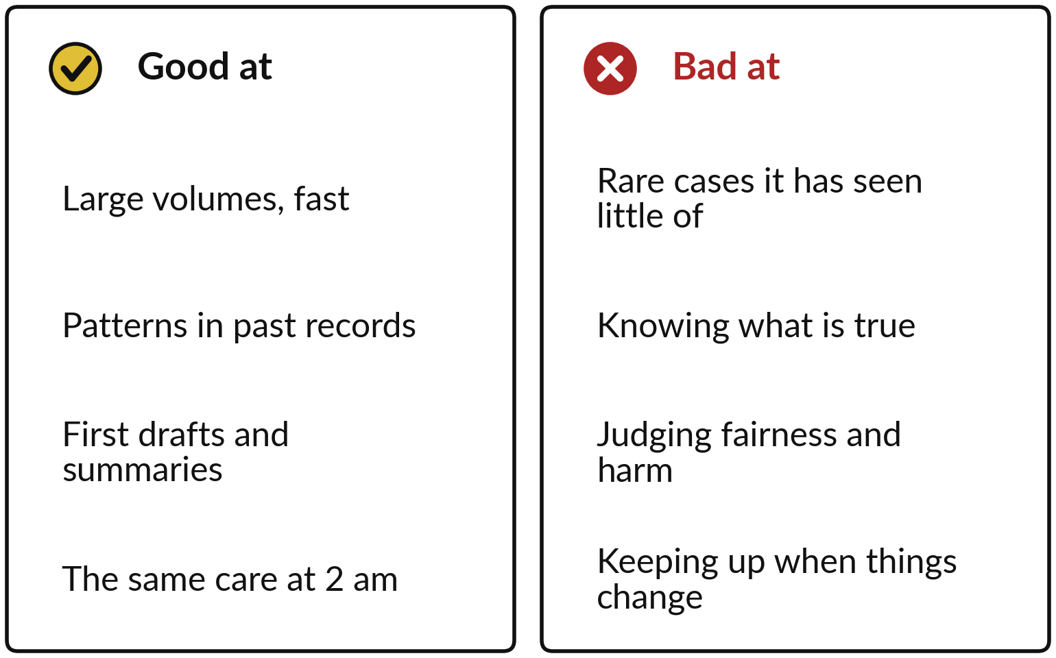
AI is good at volume and patterns,
and weak on rare cases and on truth
AI works at a scale no team can, and it fails in ways a person would not.
It can sound sure and be wrong.
It learns from the past, so it lags when the world changes.
Notes:
All four jobs share the same strengths and weaknesses, and a leader should know both before choosing a first use. AI is good at large volumes, fast; at finding patterns in past records; at first drafts and summaries; and at giving the same care at two in the morning as at ten.
It is weak on rare cases it has seen little of, such as a new kind of fraud. It has no built-in sense of what is true, so a chatbot can sound sure and be wrong. It cannot judge fairness or harm for you. And because it learns from the past, it lags when prices, customers or rules change. Two questions turn this into a place to start.

Slide 11
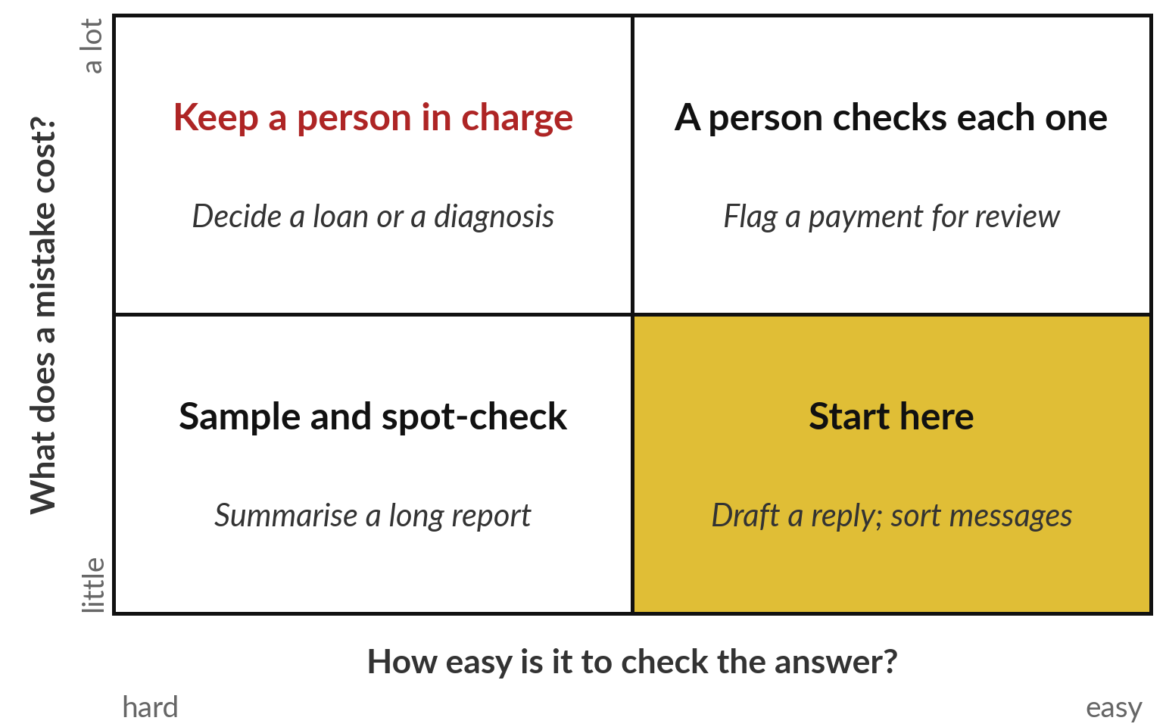
Start where a mistake is cheap
and the answer is easy to check
Two questions place any use: what does a mistake cost, and how easily can someone check the answer?
Drafts and sorting are the usual first wins.
Loans and diagnoses keep a person in charge.
Notes:
Strengths and weaknesses become a practical rule when you ask two questions of any use. What does a mistake cost?
And how easy is it to check the answer?
Where mistakes are cheap and checking is easy, start there: drafting a reply or sorting messages, where a person glances and corrects. Where a mistake costs a lot but checking is easy, such as flagging a payment for review, a person checks each one. Where checking is hard but mistakes are cheap, such as summarising a long report, sample and spot-check.
And where both are hard, a loan decision or a diagnosis, keep a person in charge. Which box holds the first use you have in mind?

Slide 12
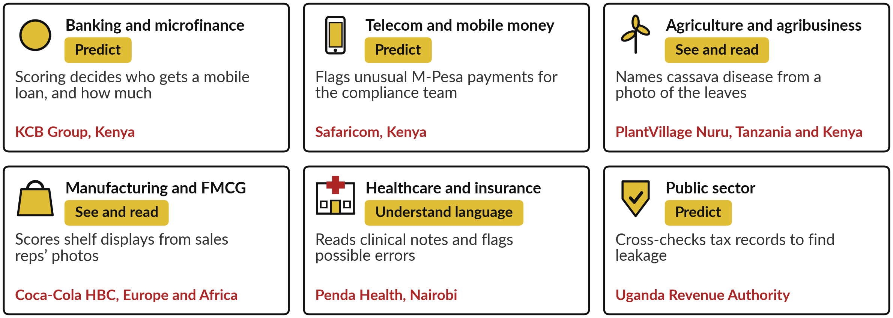
AI is already at work in all
six of our main industries
One real organisation and its AI job per tile. Act, the newest job, waits for Session 10.
Notes:
With that rule in mind, let us see where AI already works, because the strongest argument is what your peers are doing. This is our industry tour, and every session from 1 to 10 has one. In banking, KCB Group in Kenya uses scoring models to decide who gets a mobile loan and how much.
In telecom, Safaricom flags unusual M-Pesa payments for its compliance team. In agriculture, PlantVillage Nuru names cassava disease from a photo. In FMCG, Coca-Cola HBC scores shelf displays from sales reps’ photos. In health, Penda Health in Nairobi flags possible clinical errors. And in the public sector, URA cross-checks tax records.
Which tile is closest to your business?

Slide 13
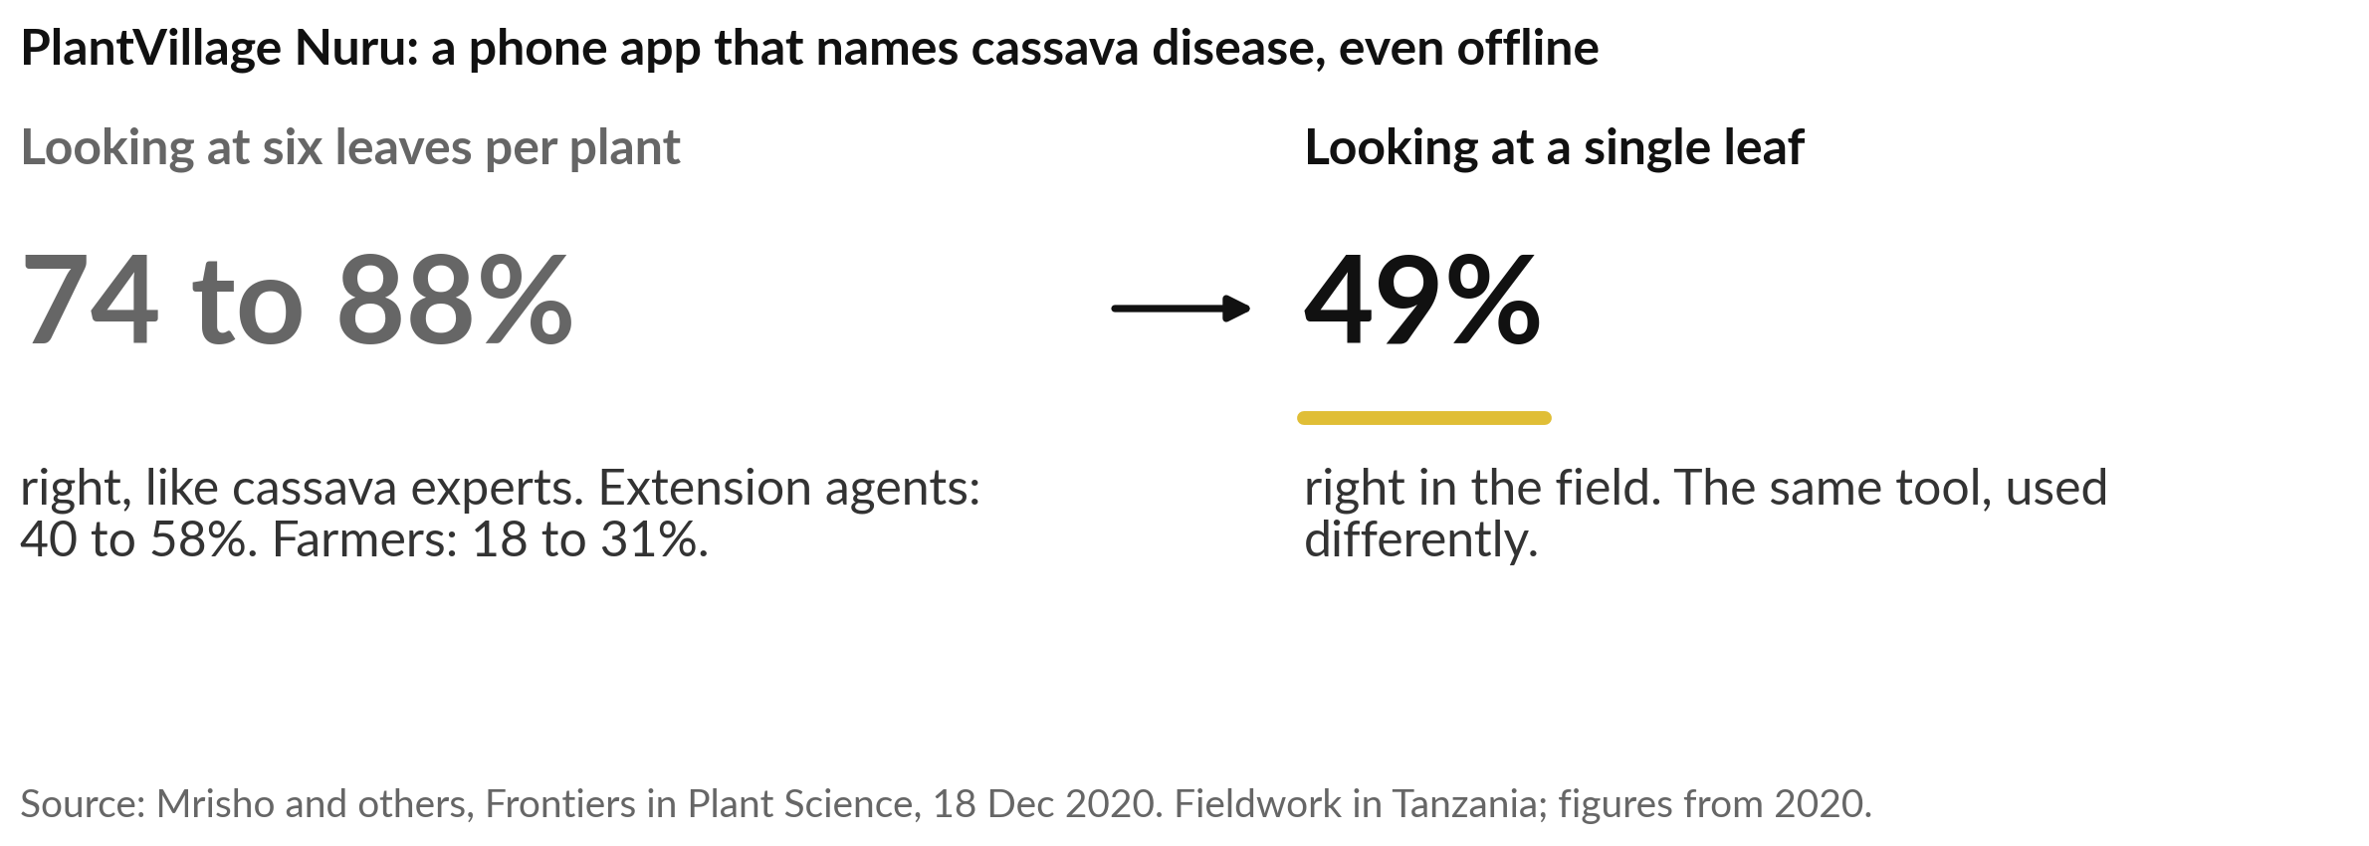
PlantVillage Nuru matched cassava experts
on six leaves, and fell to 49% on one
Ask any vendor: accurate under which conditions?
Notes:
Three of those tiles are worth opening as stories, starting in the field. Cassava disease spreads fast, and there are too few experts to tell the diseases apart. PlantVillage Nuru lets a farmer or extension worker point a phone at the leaves; the app names the disease and gives advice, even offline.
A peer-reviewed study in 2020 found it 74 to 88 percent accurate when it examined six leaves per plant, similar to cassava experts and better than extension agents and farmers. On a single leaf, accuracy in the field fell to 49 percent. The same tool, used differently, gave a very different result.
Session 3 turns this into a habit: always ask, accurate under which conditions?

Slide 14
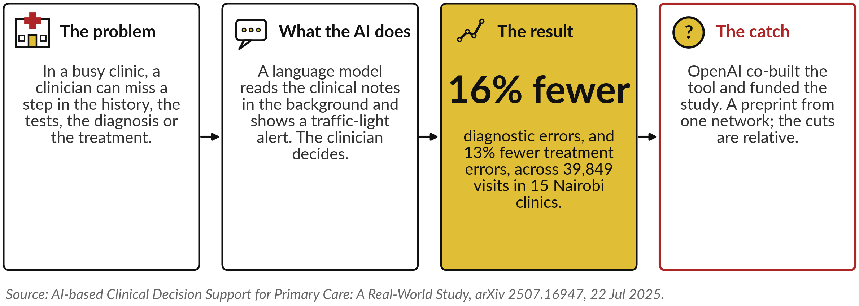
Penda Health clinicians with an AI safety
net made 16% fewer diagnostic errors
The AI checks the person, and the person decides.
Notes:
From a phone in the field to a clinic in Nairobi, and a different job: understanding language. In a busy clinic, a clinician can miss a step in the history, the tests, the diagnosis or the treatment. Penda Health runs a tool that reads the clinical notes in the background and shows a traffic-light alert, and the clinician keeps the decision.
Across 39,849 visits in 15 clinics, clinicians with the tool made 16 percent fewer diagnostic errors and 13 percent fewer treatment errors than those without it. Three cautions: OpenAI co-built the tool and funded the study, it is a preprint from one network, and the reductions are relative.
The design is worth copying: the AI checks the person, and the person decides. Session 5 comes back to this case.

Slide 15
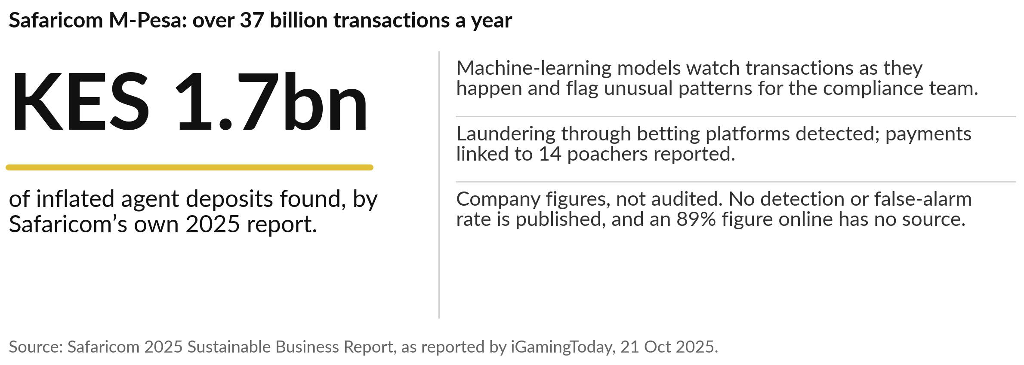
Safaricom says its AI monitoring found
laundering through betting firms on M-Pesa
A flag is a lead for a person to investigate.
Notes:
Our third story is the prediction job, in mobile money. M-Pesa carries over 37 billion transactions a year, and laundering and fraud hide among them. Safaricom uses machine-learning models that watch transactions as they happen and flag unusual patterns for its compliance team. Its 2025 sustainability report says this uncovered laundering through betting platforms, found inflated agent deposits of 1.7 billion Kenya shillings, and led to payments linked to 14 wildlife poachers being reported.
These are company figures. No detection rate or false-alarm rate is published, and an 89 percent figure you may see online has no traceable source. So a flag is a lead, and people still investigate. Ask any vendor how such a claim was checked.

Slide 16
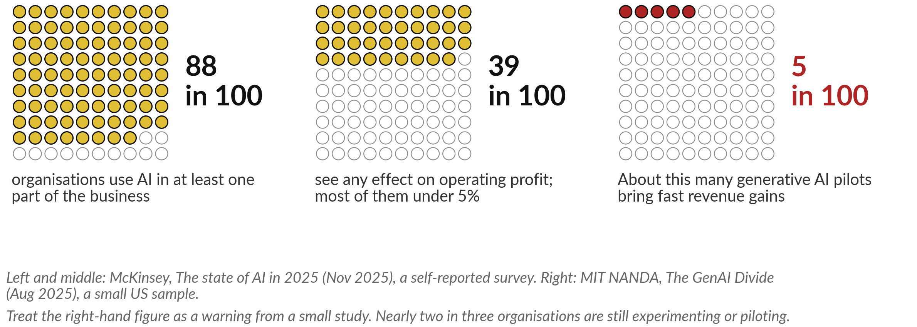
Most organisations now use AI, few see
it in their profit, and many pilots stall
The gap between trying AI and profiting from it is what this course is about.
Notes:
Three good stories can make it sound easy, and the wider evidence is less kind. McKinsey’s 2025 survey found that 88 in 100 organisations use AI in at least one part of the business, yet nearly two in three are still experimenting or piloting. Only 39 in 100 see any effect on operating profit, which the industry calls EBIT, earnings before interest and tax, and for most of them it is under 5 percent.
A smaller MIT study in 2025 claimed that only about 5 in 100 generative AI pilots bring fast revenue gains. Treat that one as a warning, because its sample was small. The lesson for you: using AI is common, and getting value from it is still rare.

Slide 17
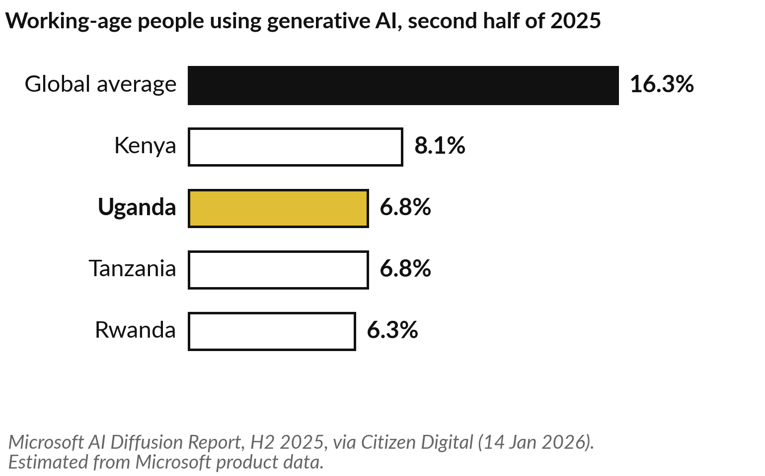
In Uganda about 7 in 100 working-age people
use generative AI, under half the global average
Most of your customers and staff have barely started.
It counts people; firms are measured elsewhere.
It is a Microsoft estimate from its own product data.
Notes:
Closer to home, the gap is wider. Microsoft estimates, from data on the use of its own products, that in the second half of 2025 about 6.8 in every 100 people of working age in Uganda used generative AI. Tanzania was also 6.8, Rwanda 6.3 and Kenya 8.1, against a global average of 16.3.
This counts people, and it is a vendor’s estimate, so read it as a direction. For you it means two things. Most of your customers and staff have barely started, so there is room to move early. And the skills gap is real, which is why Session 12 is about people.
Is that what you see in your own organisation?

Slide 18
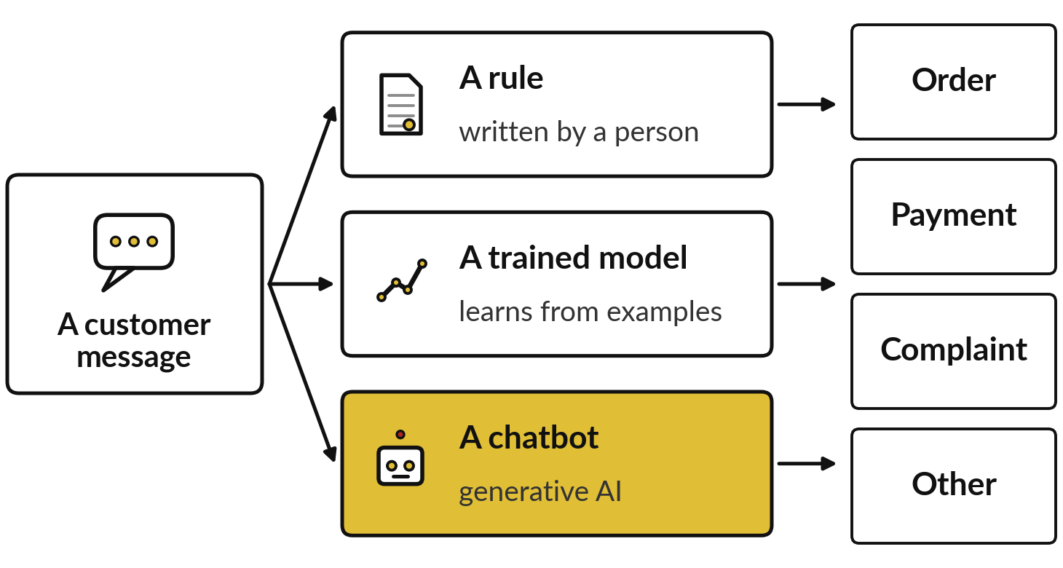
One task done three ways, by a rule, a
trained model and a chatbot, in recorded runs
I will show
Watch for
Which messages fool the rule
How many examples the trained model learned from
Where the chatbot is wrong, and how sure it sounds
Notes:
Survey numbers tell you what others report. Now I want you to see the family at work on one task, using recorded runs. Nile Valley Foods is a fictional food distributor in Jinja that we use throughout the course. Its customers send messages by WhatsApp and email, and each must be sorted as an order, a payment, a complaint or other, so it reaches the right desk.
We hand the same messages to three members of the family: a rule written by a person, a model trained on labelled examples, and a chatbot. Watch which messages fool the rule, how many examples the model had, and where the chatbot goes wrong. Every result I show is from a recorded run.

Slide 19
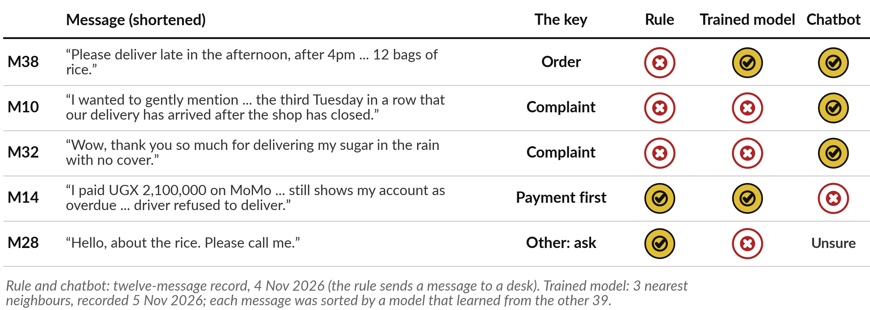
Sarcasm and politeness fool the rule, and the
chatbot confidently misreads one payment message
The key is the answer agreed in advance for each fictional message.
Notes:
Five of the messages show what each method did. M38 asks for delivery late in the afternoon; the rule saw the word late and sent it to complaints. M10 is a polite complaint with no angry words, and both the rule and the trained model missed it. M32 says thank you for delivering sugar in the rain with no cover; the words are kind and the meaning is a complaint.
Only the chatbot read the sarcasm. But look at M14: a customer paid and is still marked overdue. The chatbot called it a complaint, with confidence, when Finance must act first. And on M28 it said unsure, which is what a person would say.

Slide 20
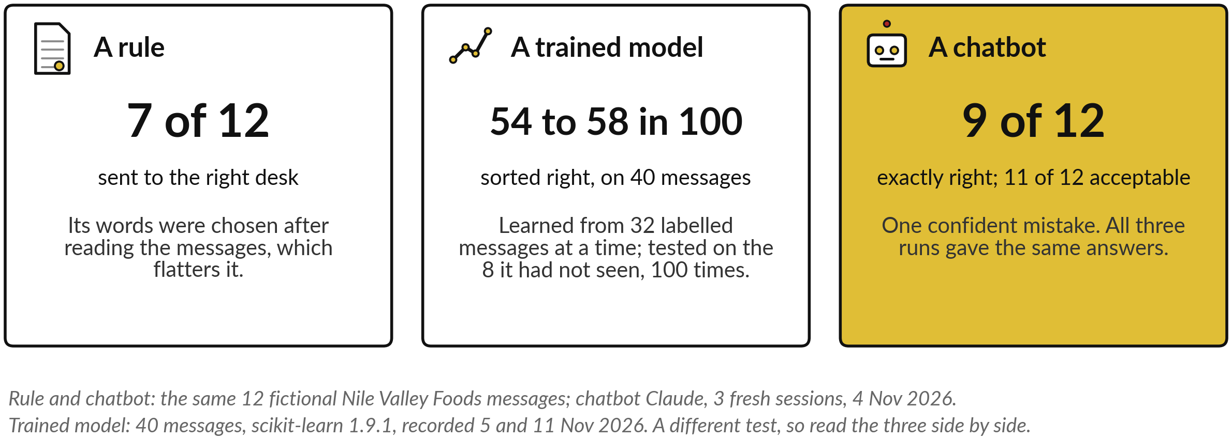
The rule sorted 7 of 12 and the chatbot 9 of
12; the trained model scored about 55 in 100
Compare the rule and the chatbot directly. The trained model sat a different test.
Notes:
On the same twelve messages, the rule sent 7 to the right desk, and its words were chosen after reading the messages, which flatters it. The chatbot, Claude in three fresh sessions on 4 November 2026 with the answer key hidden, got 9 exactly right and 11 acceptable.
The trained model sat a different test, on all forty messages: it learned from 32 at a time and was tested on the 8 it had not seen, a hundred times over, and sorted 54 to 58 in 100 right. A longer keyword rule scored 23 of 40 on that set.
So read the model beside the others: forty examples is far too few to learn language. Session 11 returns to these twelve messages to put a value on the work.

Slide 21
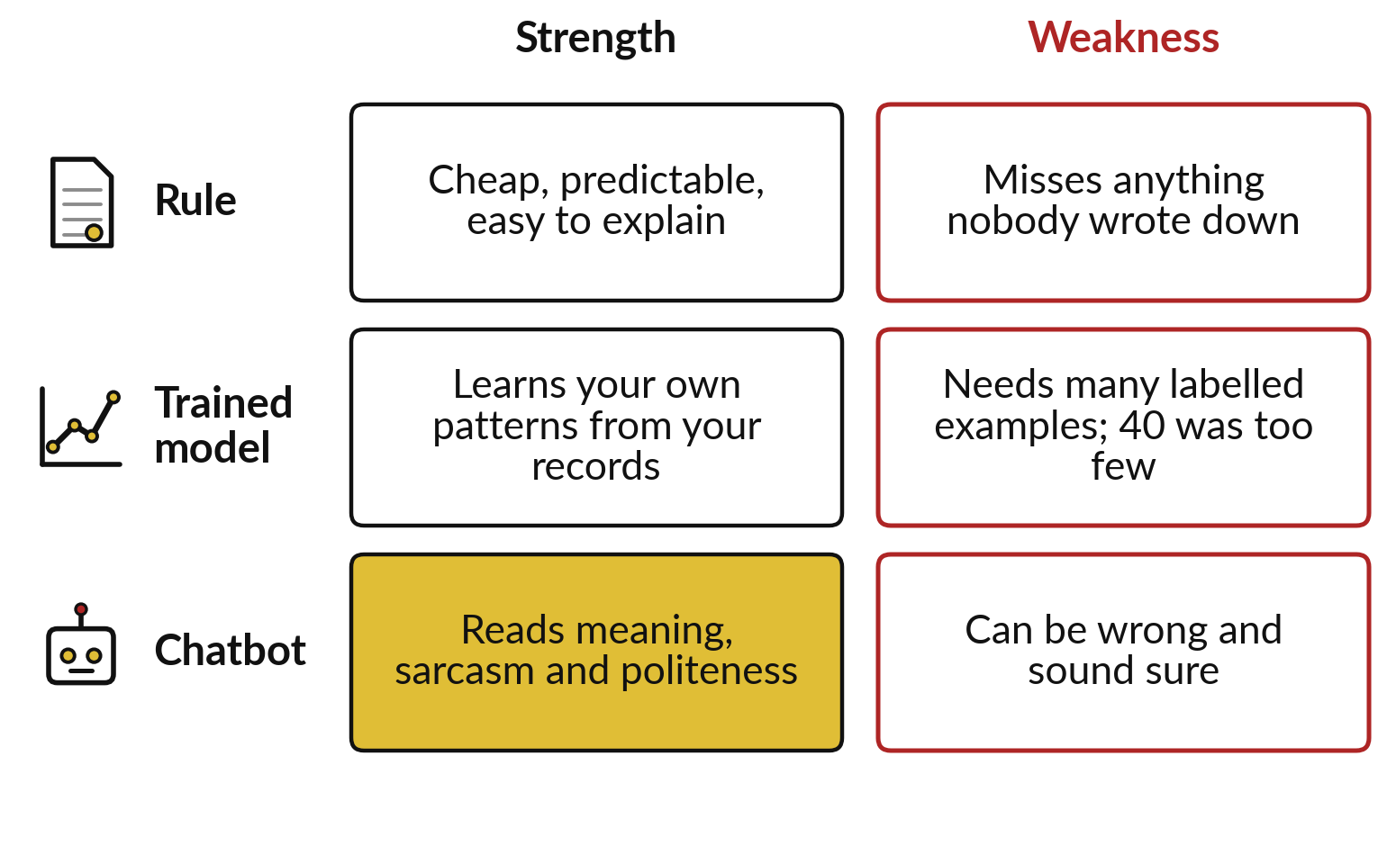
Each member of the family fails in its own
way, so each needs a person checking
Rules miss what nobody wrote down, models need many examples, and chatbots can be wrong and sound sure.
Choose by the job and the cost of a mistake.
Session 3 shows how to judge any accuracy claim.
Notes:
So what did the demonstration show?
Each member of the family has its own strength and its own way to fail. The rule is cheap, predictable and easy to explain, but it misses anything nobody wrote down, such as sarcasm. The trained model learns your own patterns from your own records, but it needs many labelled examples, and forty was far too few.
The chatbot came to the task already trained on vast amounts of text, so it read politeness and sarcasm, yet it still made one confident mistake. No member is right for every task. You choose by the job and the cost of a mistake, and you keep a person on the doubtful cases.

Slide 22
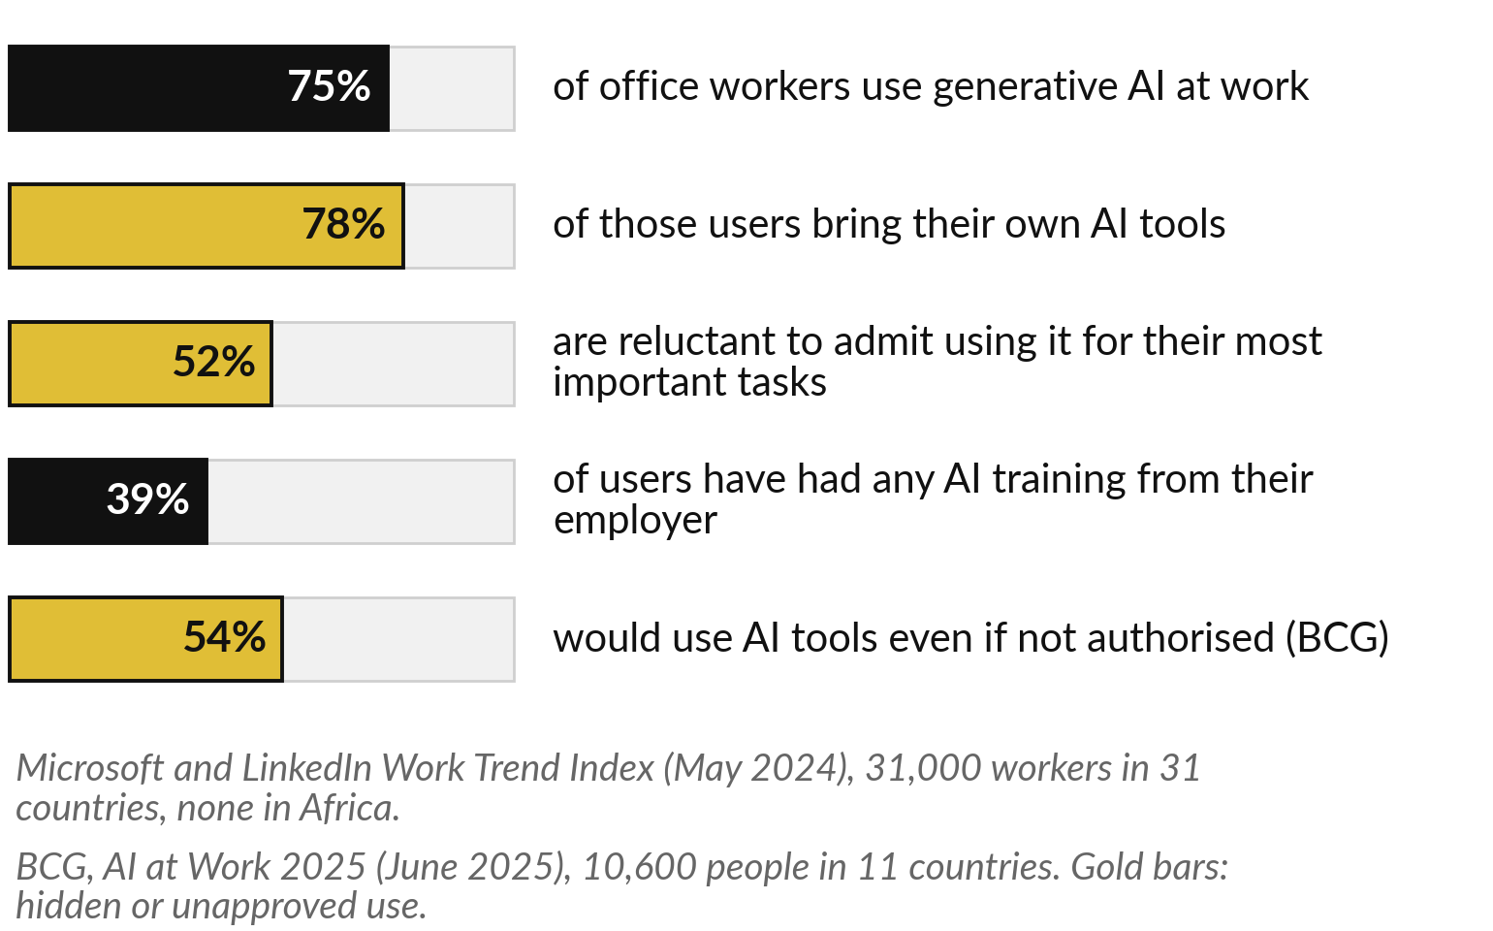
Many staff already use AI tools at work without
telling anyone, which is called shadow AI
Your company data may already be in tools nobody approved.
Most users bring their own tools.
Few have been trained by their employer.
Notes:
Welcome back. The demonstration showed tools that need a person checking, which raises a question about your own people: who already uses these tools?
Often more than you think. When staff use AI tools at work without approval, the industry calls it shadow AI. Microsoft and LinkedIn surveyed 31,000 office workers in 2024: 75 percent used generative AI at work, 78 percent of those brought their own tools, and 52 percent were reluctant to admit using it for their most important tasks.
Only 39 percent had any training from their employer. In BCG’s 2025 survey, 54 percent would use AI even if not authorised. No African country was sampled, so ask your own people.

Slide 23
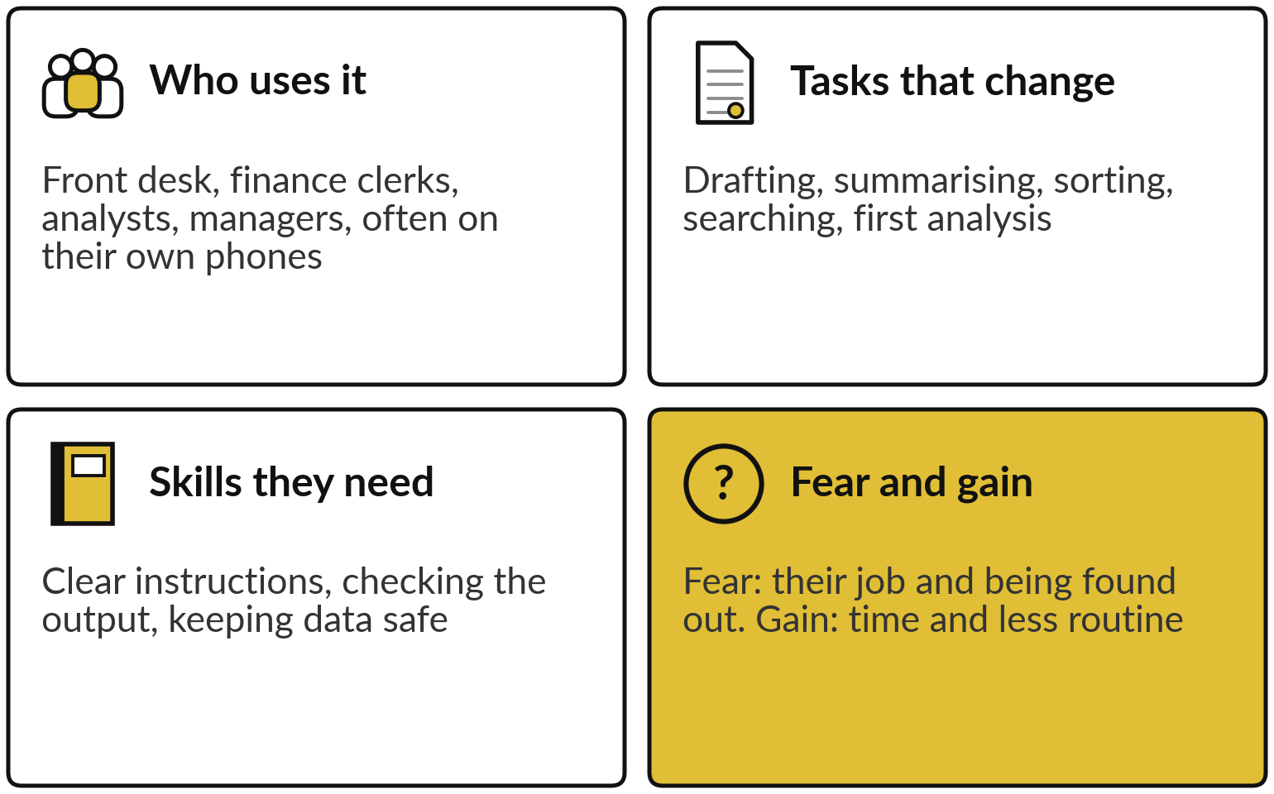
Ask who uses AI, which tasks change,
what skills people need and what they fear
Every session from 1 to 10 ends its tour with a slide like this one.
In a 2025 BCG survey, 41% feared their job could disappear within ten years.
Session 12 brings it all together.
Notes:
Shadow AI is a sign of demand, so let me map your people the way every later session will. Who uses it: often the front desk, finance clerks, analysts and managers, sometimes on their own phones. Which tasks change: drafting, summarising, sorting, searching and first analysis. What skills they need: writing clear instructions, checking what comes out, and keeping company data safe.
And what they fear and gain. In BCG’s 2025 survey, 41 percent worried their job could disappear within ten years. Fear of being found out also keeps use hidden. The gain is time and less routine work. Session 12 turns all of this into a people plan.

Slide 24



Three questions to ask your
team this month, without blame
Which AI tools do you use for work, and for what?
What company or customer information has gone into them?
What would help you use AI well and safely?
Notes:
The quickest way to find your own shadow AI is to ask, and to ask without blame. Here are three questions for your team this month. First, which AI tools do you use for work, and for what tasks?
Second, what company or customer information has gone into them?
That one matters, because personal data about customers falls under Uganda’s Data Protection and Privacy Act, 2019. Third, what would help you use AI well and safely?
If people fear punishment, they hide their use, and you lose both your view of the risk and their good ideas. Session 13 turns the answers into a policy.

Slide 25
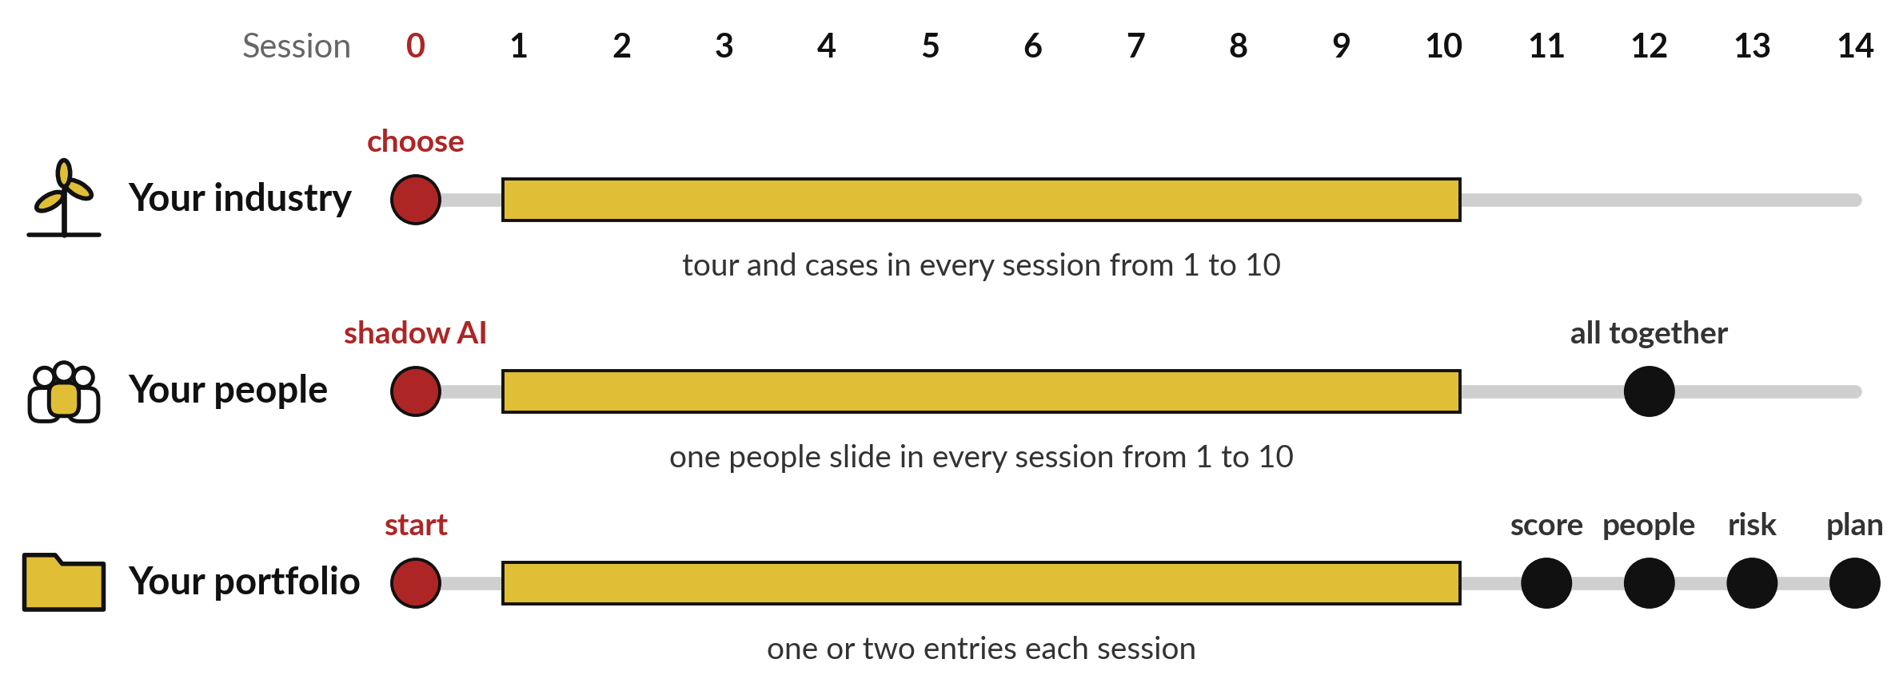
Three threads run through every session:
your industry, your people, your portfolio
Today you choose your industry, meet shadow AI and start your portfolio.
Notes:
Those questions start the people thread, one of three threads that run through the whole course. The first thread is your industry. Today you choose it, and every session from 1 to 10 tours the six main industries and tells one or two real cases. The second is your people: one slide each session on roles, tasks, skills and fears, brought together in Session 12.
The third is your AI Opportunity Portfolio, a one-page register of possible uses in your own organisation. You add one or two entries each session. In Session 11 you score them, then add the people impact, the risk and the data readiness, and in Session 14 the portfolio becomes your ninety-day plan.

Slide 26
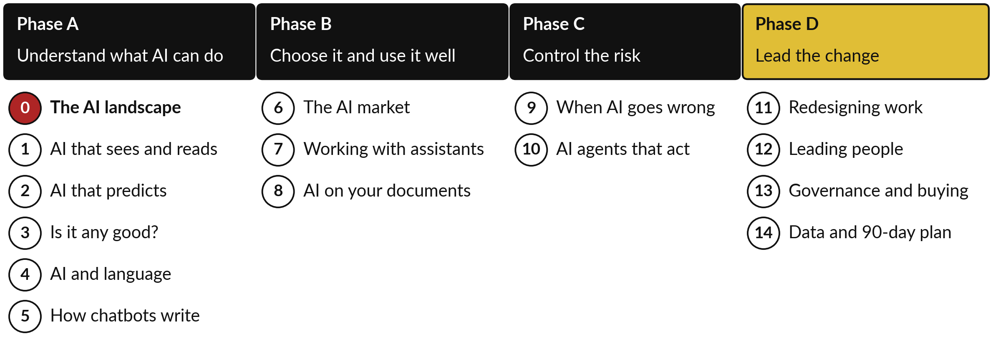
Fifteen sessions in four phases, from
understanding AI to leading the change
Phases A to C build judgement. Phase D is practical work on your organisation.
Notes:
The threads follow a route in four phases. Phase A, Sessions 0 to 5, is understanding what AI can do: today’s map, then seeing and reading, predicting, judging accuracy, language, and how chatbots write. Phase B, Sessions 6 to 8, is choosing it and using it well: the market and vendors, getting good work from assistants, and AI that answers from your own documents.
Phase C, Sessions 9 and 10, controls the risk: failures, and agents that act. Phase D, Sessions 11 to 14, is practical: you redesign work, plan for your people, set governance and buying rules, and leave with a data check and a ninety-day plan.

Slide 27
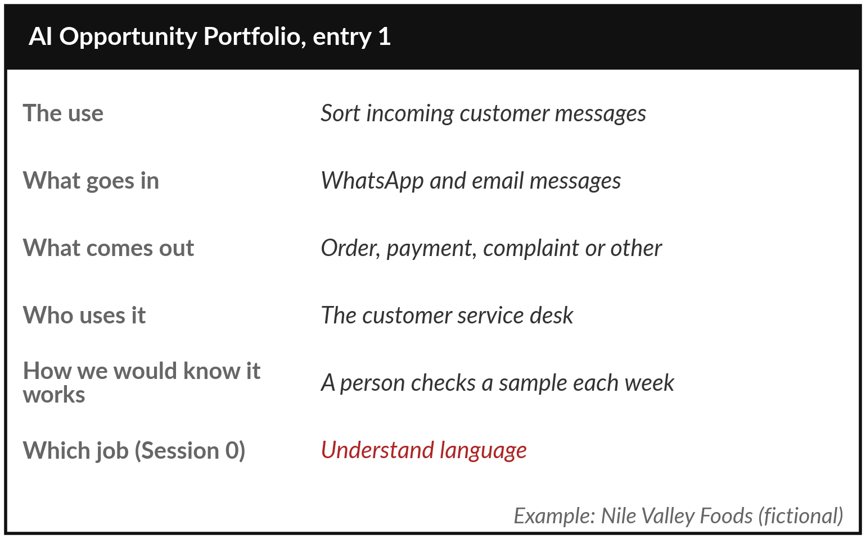
Your AI Opportunity Portfolio
starts today, with one page
Each entry names a use, what goes in, what comes out, who uses it and how you would know it works.
Today’s own column: which of the four jobs.
The example is Nile Valley Foods, a fictional company.
Notes:
Phase D works on your portfolio, so let me show you what an entry looks like. Here is one for Nile Valley Foods, our fictional distributor. The use: sort incoming customer messages. What goes in: WhatsApp and email messages. What comes out: order, payment, complaint or other. Who uses it: the customer service desk.
How we would know it works: a person checks a sample each week. And today’s own column: which of the four jobs it does, here understanding language. The line about knowing it works is a check, as the demonstration taught. Each later session adds a column, from accuracy to risk.

Slide 28
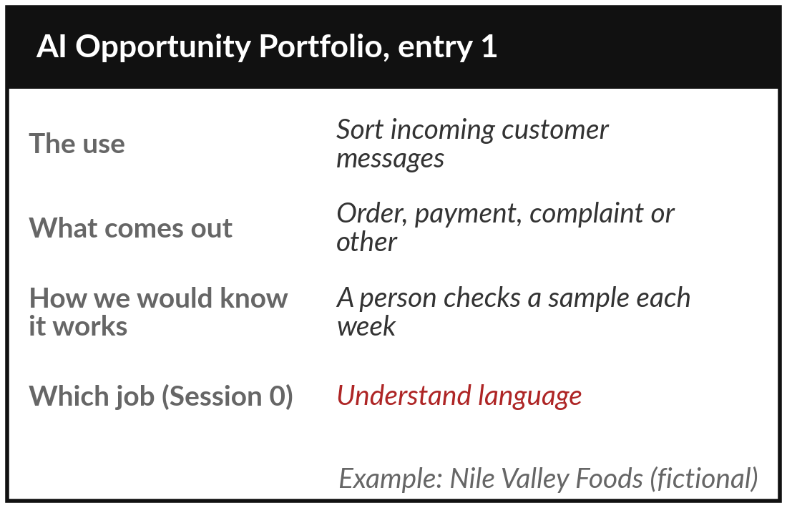
Choose your industry and write
your first two portfolio entries
15 minutes
Hands-on: your own organisation
Pick your industry, then write two possible AI uses in your organisation.
Circle your industry: one of the six, or energy, retail, education or legal.
Pick one use from today’s tour that could fit you.
Fill one entry: use, in, out, who, how you would know, which job.
Add a second entry for a different job.
You keep: Your industry and two portfolio entries.
Notes:
Now it is your turn, for fifteen minutes, and I walk round while you write. Open the Learner Workbook at the AI Opportunity Portfolio. First, circle your industry: one of the six on the tour, or energy and mining, retail and logistics, education, or legal and professional services.
That choice follows you through the course. Then pick one use from today’s tour that could fit your organisation, and fill in one entry: the use, what goes in, what comes out, who uses it, how you would know it works, and which of the four jobs it does.
Add a second entry for a different job. Rough is fine; we refine these every session.

Slide 29




What will you do about AI in the next two weeks?
Which first step fits your organisation now?
Ask
Protect
Pick
Wait
Find out who already uses AI tools, and for what
Tell staff to keep customer data out of public tools
Choose one entry where mistakes are cheap to catch
Learn through Session 3 before committing money
Write your choice and the reason in your workbook.
Notes:
Your two entries are a start, and a leader’s next question is what to do before Session 1. Here are four sensible first steps, and you may choose more than one. Ask: find out, without blame, who already uses AI tools and for what. Protect: tell staff to keep customer and confidential data out of public tools until a policy exists.
Pick: choose the portfolio entry where mistakes are cheap and easy to catch. Or wait: learn through Session 3 before committing money. Each is a reasonable choice. Which will you do in the next two weeks, and why? Tell me, and write it in your workbook.

Slide 30
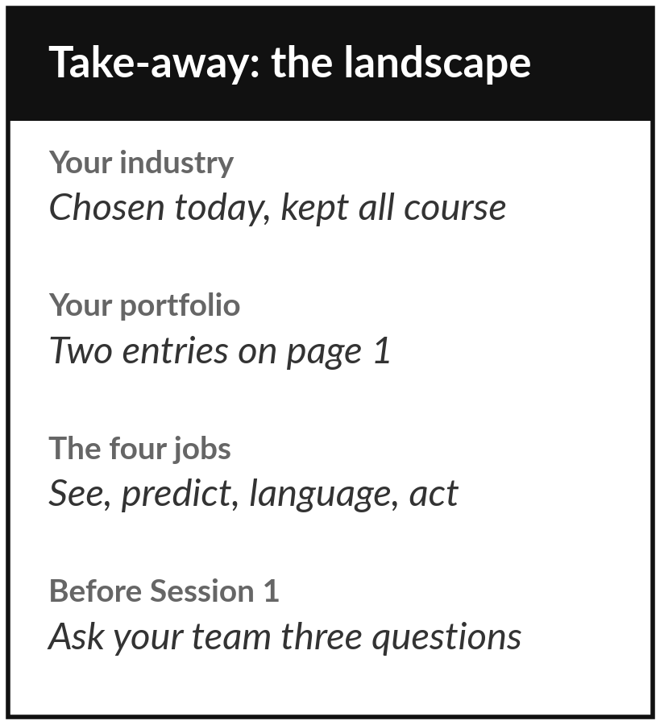
Keep your industry and the
first page of your portfolio
What you keep from today
Your chosen industry and the first page of your AI Opportunity Portfolio, with two entries. Session 1 adds a use where AI sees or reads for you.
Our question today
What is AI, in plain words, and where is it already at work in my industry?
Next session
Session 1: AI that sees and reads: images, documents and speech.
Notes:
That brings us to what you take home. You leave with your chosen industry and the first page of your AI Opportunity Portfolio, with two entries. You also hold the map: AI as a family, the four jobs, where AI already works, and why a person still checks.
Before Session 1, ask your team the three questions and note what you hear. Session 1 takes the first job, AI that sees and reads, and you will add a use where AI could see or read for you.
We began with this question: What is AI, in plain words, and where is it already at work in my industry? Before you go, say in one sentence what you can now say about it.

